Slide 1
CS 186 Exam Prep Section 5
Sorting/Hashing

Slide 2
Sorting/Hashing

Slide 3
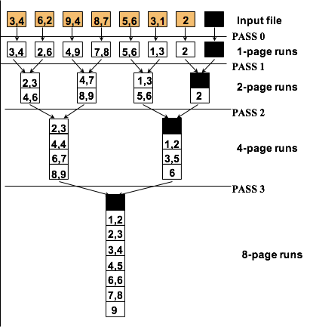
Sorting
We first sort small amounts of data into runs of sorted tuples
Given runs of sorted tuples, we can merge them into 1 larger run of sorted tuples
Same as in-memory mergesort
Stream in the two runs and stream out the new run

Slide 4
General External Merge Sort
How many passes do we need?
We sort B pages at once, so we have ⌈N/B⌉ runs after Pass 1
We merge B-1 pages at once, so we have to do ⌈log_{B-1}(# runs )⌉ merge passes
So we have 1 + ⌈log_{B-1}(⌈N/B⌉)⌉ passes over the data

Slide 5
Sorting
B buffer pgs -> merge B-1 runs at a time
Initial number of sorted runs
Read and write each page per pass
Number of passes:
First pass + each merging pass

Slide 6
Sorting
Two passes can sort B * (B-1) pages
Three passes can sort B * (B-1)² pages
P passes can sort B * (B-1)^{P-1} pages

Slide 7
External Hashing
We can’t build an in-memory hash table if there’s too much data!
Start by splitting up data into smaller pieces!
Use a hash function h_{p} to partition the data
Stream partitions to disk
If we have B pages of buffer, we can split the data into B-1 partitions (1 buffer page reserved for streaming data in)

Slide 8
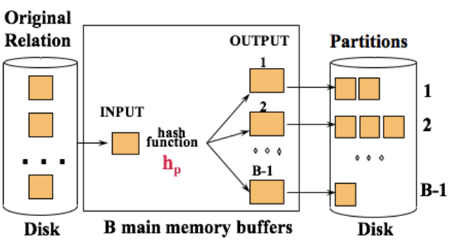
External Hashing

Slide 9
External Hashing
If the partitions are small enough to fit in memory (at most B pages), we can load them in and make an in-memory hash table for each one, one at a time
Then we can apply duplicate removal, aggregation, etc. in memory
Every tuple in a partition has the same value when h_{p} is applied!
In-memory hash table must use a different hash function (we call it h_{r}) that is independent of h_{p}

Slide 10
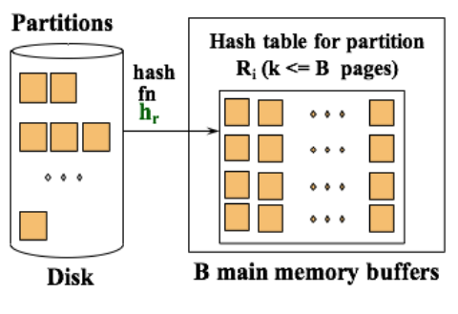
External Hashing

Slide 11
Hashing
Important: Don’t use the sorting formula for hashing
Each partition may not have the same number of pages

Slide 12
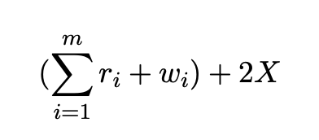
Hashing - Differs on Exams before Fall 2019
m - the total number of partitioning passes required
r_{i} - number of pages you need to read in for partitioning pass i
w_{i} - number of pages you need to write out of partitioning pass i
Factor of 2 is reading and writing each page
X - total number of pages we have after partitioning that we need to build our hash tables out of
Refer to Note 7: Hashing

Slide 13
Worksheet

Slide 14
Thanks for coming!

Slide 15

Attendance Link
https://cs186berkeley.net/attendance

